Slide 1
Lab 18

Slide 2
Goal
Combining the Linked List we made in Lab 16 and the Money Classes from Lab 17 to create a Wallet which is a Linked List of the Money type

Slide 3
Prep
Create a project for Lab 18
From Lab 17 copy over both the LinkedList and ListNode classes and refactor them renaming them to MoneyList and MoneyNode, also change the type for data to Money and make all arguments passed to be assigined to data also Money
Import all the classes from Lab17 other than the MoneyMain class
Import the Wallet and WalletMain files for this Lab

Slide 4
Implement addToWallet
First you will need to implement addToWallet in the Wallet class
What you basically want to do is append the Money object passed as an argument to the walletContents

Slide 5
Implement print
You want to implement print similar to how bills and coins are printed line by line in lab 16.
The method is called in the Wallet class however the MoneyList’s nodes are not accessible from the Wallet Class
To circumvent this we need to either implement a method in the MoneyList that is called by the method in Wallet, change the access of the first and last MoneyNodes in the Monely List class to public or utilize get methods for first and last from MoneyList
Once we figure out how we will access the nodes in the list we want to loop through the node and print out the Money values for each node using a loop similar to toString method in the LinkedList that was already provided, remember that we implemented toString for Bills and Coins so we can simply print the Money at each node to get our output

Slide 6
Implement getValue
Similar to the above method we will need to circumvent access to the nodes in the MoneyList
We then need to implement getValue similar to how we did in MoneyMain from Lab16 summing up the Bills and the Coins and properly calculating the dollar and cents value returning a formatted string (dd.cc) (The $ sign is included in WalletMain)

Slide 7
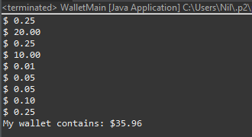
Check
If everything is done correctly you should be able to run the WalletMain class and get this output
Keep these files handy they will be used for project 3

